Slide 1
Payroll Services
Overview
Interstar Financial
[INSERT YOUR LOGO HERE]

Slide 2
Are you either…
Spending too much time on payroll?
Afraid of mistakes that could lead to IRS penalties?
Paying a lot for
payroll services?

Slide 3
We Offer Service You Can Trust
Whatever your payroll question, we are here to help. You can rely on us for top quality service – all year long!

Slide 4
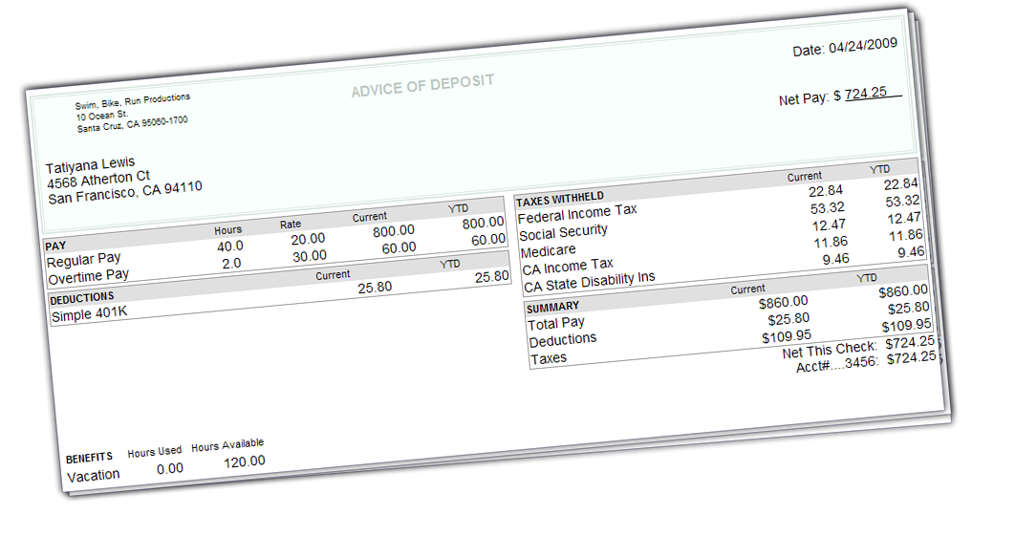
We provide:
We Make Paydays Easy and Accurate
Each payday, just provide us with employee hours and we’ll take care of the rest
Direct deposit with detailed pay stubs
Support for wide range of pay types
Sick, vacation and holiday pay accruals
Federal, state and local tax calculations
Voluntary deduction calculations
Paycheck printing
Online employee access to pay stubs
Contractor payments
Multi-state payroll
100% accuracy guarantee

Slide 5
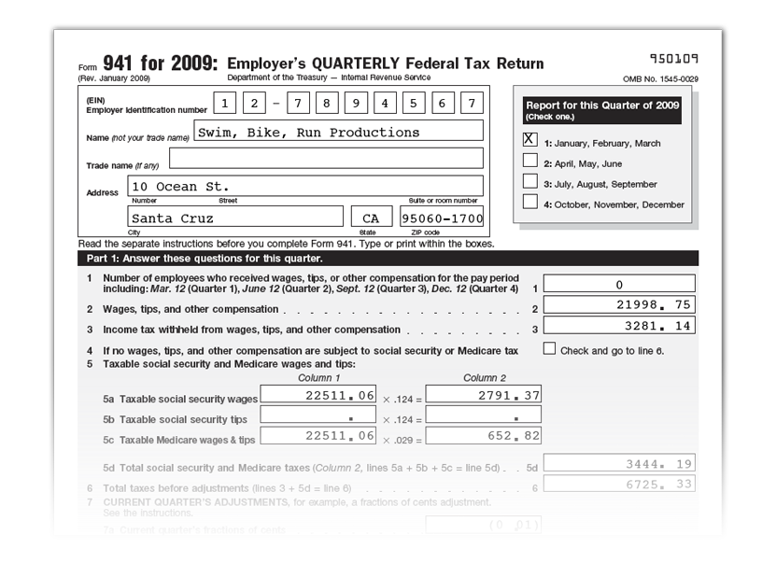
We Handle All Your Federal and State Taxes
You never have to worry about upcoming tax obligations… we take care of everything.
This includes:
Federal Tax Deposits
Quarterly 941s
Annual 940s and 944s
Employee W-2s
1099-MISC Filing
State Tax Deposits
Quarterly State Tax Forms
Annual State Tax Forms

Slide 6
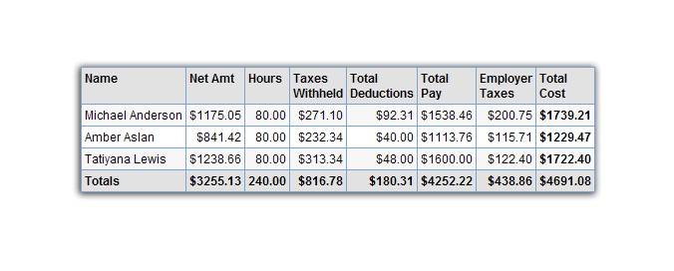
We Provide Easy-to-Read Reports
You’ll get easy to understand, detailed reports so you will always be current on payroll information.
Our detailed reports include:
Payroll Summary
Paycheck Details
Deductions
Last Paycheck
Employee Details
Contractor Details
Tax Liability
Tax and Wages
Total Pay
Tax Payments
Workers’ Comp
Check Register
Vacation and Sick Leave
Billing Summary
Total Cost
Retirement Plans
Contractor Payments

Slide 7
We Make Workers’ Compensation Payments Easy
Automatically pay workers’ compensation premiums to The Hartford, one pay period at a time
Stay in Control Of Cash-Flow
Elimination of a large down payment
Pay premiums one pay period at a time
Avoid year-end surprises
Save Time
No checks to write
Minimize audit activity

Slide 8
Our Pricing is Simple and Cost-Effective
On Your Own Payroll
On line payroll services that lets you handle 100% of the responsibiity, including calculating payroll, wrting check and/or direct deposit, and all tax filings
Interstar Tax Filing For On Your Own Payroll
Custom Payroll
Includes us handling your payroll, printing checks, filing quarterly returns, and providing monthly reports
As Low As 24.95 per month
$30 one time set up fee
As low as $9.95 per report
As Low as $39.95 per month
Prices subject to change.

Slide 9
Get Started Today!
Contact us to schedule a payroll appointment today. You’ll be delighted with the results!
Interstar Financial
813.426.3600

